Slide 1
Credit Rating
Ravi Shastri
Krishanu Ghosh

Slide 2
Overview
Objective
Detailed description of the dataset
Pre-processing
Attribute Selection Algorithms
Thresholds and Accuracy
Classification Methods
Results
Discussion and Conclusion

Slide 3
Objective
Create a rating system which rates stocks/companies based on financial ratios and generates rating recommendations
We can rate nonpublic companies under initial public offering, private equity or private debt situations. We also propose to use this model to rate existing and new debt issues.
Any difference between the ratings generated by the model and the ratings provided by a ratings agency can provide a great trading opportunity.

Slide 4
Detailed description of the dataset
Financial parameters and ratios of 453 SP 500 companies and classification attribute is their Issuer credit rating. Each row represent a single company.
Financial performance parameters - 14
Working Capital, Accounts and Notes Receivable, Sales 5 Year Average Growth, Gross Margin, Operating Margin, Return Com Equity, Return on Asset, Cash from Operations, Free Cash Flow, Invent Turnover, Account Receivable Turnover, Accounts Payable Turnover, Book Value Per Share
Financial ratios - 9
Quick Ratio, Interest Coverage Ratio, Average Equity to Average Asset, Total Debt to Total Equity, Debt to Total Asset, Debt to Com Equity, Dividend Indicated Yield Net, Tobin Q Ratio
Class Attribute - Credit rating. Total 18 distinct values in Class Attributes

Slide 5
Data Preprocessing
Initial load of data in WEKA
Input file updated with all the missing values replaced by mean / mode.
Manually stripped the file with less number of attributes and tuples.
Controlling for number of missing values.
Manual preprocessing actions
Tuples with noisy data removed from dataset. Ex - Attribute “Book Value per Share” as “#NA Field Not Applicable” removed from in dataset.
Tuples with related ratios as zero removed from the dataset.
Tuples with classifiers BB+/BBB+ OR BB-/BBB- are updated to BBB for benefit of classifier analysis. The same is performed on A’s.
At this point we have 6 class values (A,AA,AAA,B,BB,BBB)

Slide 6
Data Preprocessing (Contd)
Initial Classification runs
Run J48 and Naïve Bayes after manual pre-process of data. Performance noted under 60% and we are inclined to further pre-processing.
Smoothing class attributes and revised run
Smoothed data further by Binning the classifier values to relatively smaller set A and B. Classified all A/AA/AAA to A and all B/BB/BBBs to B.
Objective: use the pre-processed file and using the different classification schemas to come up with a model that will classify a company into A or B rating using the financial ratios.
Classification run on revised dataset
Result of revised classification runs recorded 71%. We made this version as our pre processed base version for classification runs.

Slide 7
Attribute Selection Algorithms
Attribute selection Algorithms used for classifier-based threshold selection
Info Gain - Information gain of attributes with respect to class attribute.
Principal Components Analysis - Principal components analysis and transformation
Correlation based - Calculate correlation between each attribute and the class and select based on a threshold of correlation value
ReliefF - Repeatedly sampling and considering the value of attribute for the nearest instance of the same and different class.
Symmetrical Uncertain - Measurement of symmetrical uncertainty with respect to the class.

Slide 8
Thresholds & Accuracy
Attribute Selection | InfoGain | Principal Comp with 95% Var / 5 Attributes. | Correlation | ReleifF | SymmetricalUncert
Rank Threshold | .0374 | .4 | .1 | .005707 | .0398
No of Attributes | 10 | 7 | 15 | 9 | 9
Naive Bayes | 75% | 74% | 77% | 76% | 75%
J48 | 75% | 74% | 74% | 75% | 76%

Slide 9
Classification Methods
Classifiers Used: Naive Bayesian, J48, KNN with 5, Random Forest on stand alone basis / with bagging under cross validation on input files generated using the various attribute selection algorithms.
Arranged the scores for each classifier across these measures and obtained optimal performance score across the various classifier runs (after systematically shrinking the classifier values, we ended with two class values - A and B)
Performance Measures: Correctly classified rate, Incorrectly classified rate, TP rate, FP rate, F measure, ROC Area.

Slide 10
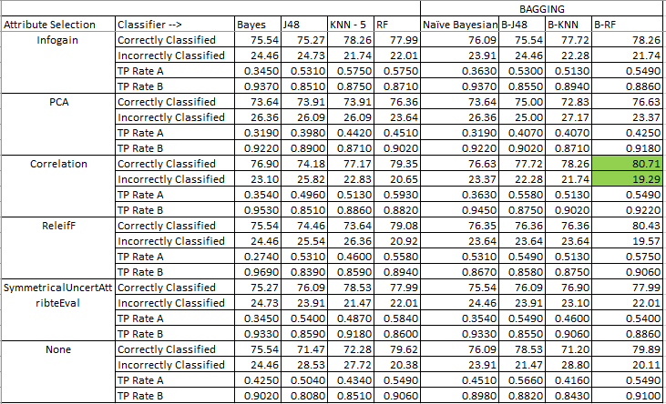
Results

Slide 11
Results (Contd)
Optimal Scores:
Considering the different results of the various runs, we chose correlation attribute selection with Random Forest Classifier under bagging as the best performer (with the following scores):
CCR | ICR | TPR A | TPR B | FPR A | FPR B | F msr A | F msr B | ROC A | ROC B
80.7065 | 19.2935 | .5830 | .9690 | .0310 | .4070 | .6440 | .8690 | .8780 | .8780
CCR | ICR | TPR A | TPR B | FPR A | FPR B | F msr A | F msr B | ROC A | ROC B
80.765 | 19.2935 | .5490 | .9220 | .0781 | .4510 | .6360 | .8690 | .8680 | .8680

Slide 12
Discussion and Conclusion
We run suitable selection of 5 attribute selections and classifications and were able to reach 80.16% for the final model vs 79% from raw input file.
The model using Random forest classification under bagging on Correlation attribute selection has the best performance.
To get the fuller insight, the data set needs to be enhanced and the exercise of multiple attribute selection and classification repeated.
We plan to get a larger set consisting of Russel 2000 and MSCI indices and re-run the process to ensure we are classifying into the full slate of the attribute values.

Slide 13
Q & A

